Slide 1


Solution to the theme Medicine and Technology
CodeScrappers

Slide 2

Our problem statement was to devise a method by which the gap between the patient and the doctors will become less so that detecting and curing the disease can be done at an early stage and the life of the individual can be saved, due to Covid-19.
We have to create something which makes funds for lower strata people who are in financial problems due to the lockdown for Covid19.

Slide 3



1) An user-friendly website. 2) Helps people with financial crisis by distributing the funds from government. 3) Provides food to the people who need it. 4) Provides shelter to people who need it. 5) Provides medicine and masks to the people who need it.
This is a website which provides fund for the financial crisis facing people by distributing the government funds, along with food, medicine & shelter requirements

Slide 4

We want to provide food, medicine , masks, shelter, funds to those who are in need due to the lockdown, so we made a website to solve the problem.

Slide 5


People will find it easier to use a website in any form factor so a website is best .

Slide 6

A special dedicated slide for prototype
String point : Helping people with need of food , medicine funds , shelter in time.
Weak point : Due to less time we are not able to get all data to set proper website.

Slide 7
TARGET MARKET
We plan to target all of Indian polulation of lower strata especially since they need it the most.

Slide 8
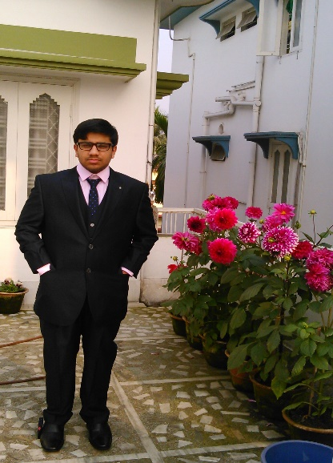
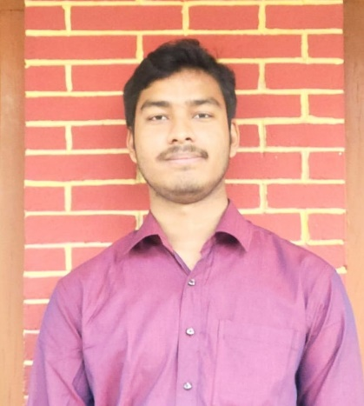


TEAM DESCRIPTION
Dipayan Saha
KIIT 3rd year
Tuhin Manna
KIIT 3rd year
Shourya Roy
KIIT 3rd year

Slide 9


thanking you
kindly attend our youtube live sessions
R E G A R D S : A B H I N A V S R I V A S T A V A

